Slide 1
Modern Migration Tour
Beating the end of support of SQL Server 2008/R2

Slide 2




Christian Araujo
Experiencia
MCSE Data management and Analytics
Azure architect technologies certified
Mas de 10 años de experiencia en bases de datos
Comunidades
Guatemala SQL Server User Group
Azure Guatemala
Regional SQL Architect, GBM
/Charaujo
@charaujo
cfaraujo@gbm.net

Slide 3
Beating the end of Support
Evaluación a nivel empresarial de los beneficios de migrar hacia una plataforma de datos moderna

Slide 4
Deadline to act before end of support
Impact of end of support
No security updates
SQL Server 2008 and 2008 R2
Extended Support
ends July 9, 2019
Compliance concerns
Windows Server 2008 and 2008 R2
Extended Support
ends January 14, 2020
Missed innovation opportunities
2018
2019
2020
Find lifecycle support deadlines at: support.microsoft.com/lifecycle
Notes:
For Windows Server 2008 and Windows Server 2008 R2, end-of-life mainstream support ended January 14, 2015—and Microsoft ends Extended Support on January 14, 2020.
Likewise, Extended Support for SQL Server 2008 and 2008 R2 ends July 9, 2019. The database is often tied to one or more applications running on Windows Server, so it makes sense to look at both as you build your EOS plan.
Many organizations are running workloads on Windows Server 2008 and 2008 R2. You can continue to use Windows Server 2008 R2 safely in your environment’s architecture, at least until the extended support expiration date.
If you put off action, however, you miss out on new security and efficiency features that could easily justify a move – either to Azure or Windows Server 2016. Take the time to assess your options and make decisions that are right for your organization. With the right strategies, you can make sure your organization is protected and your infrastructure secure.

Slide 5


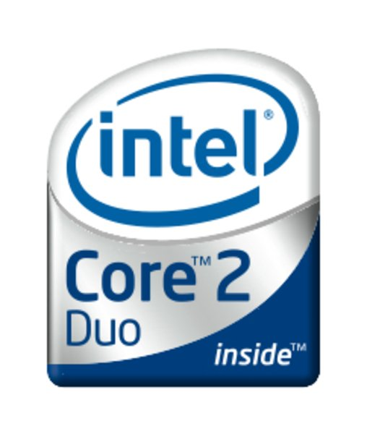
Tecnologías de 2008

Slide 6

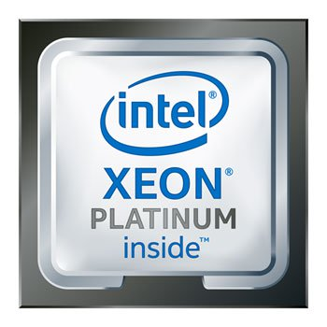
Tecnologías de 2019

Slide 7
Alternativas de migración
Lift-and-shift to PaaS with Azure SQL Database Managed Instance (MI)
SQL DB MI takes source version as far back as SQL Server 2005; no more future upgrades required as SQL DB will always run on the latest feature as part of fully managed services
SQL
Modernize to Azure
SQL Server 2008/R2 end of support
Move to IaaS with Azure SQL VM
Upgrade to SQL Server 2017 on Azure VMs, or
Move “as-is” with SQL Server and Windows Server 2008/R2 and get 3 years of Extended Security Updates* for free
Modernize on premises
Upgrade on premises
Upgrade to SQL Server 2017** (and Windows Server 2016)
* ESU worth 75% of license every year for the next three years after EOS
Notes:
For customers who experience EoS for SQL 2008/R2, they will have 3 options to upgrade to the latest version of our software to help reduce security risks and continue to get regular security updates. These are:
Migrate to Azure SQL database managed instance (SQL Database MI) – PaaS option
Migrate to Azure SQL VM – IaaS option
Stay on-premise and upgrade
End of Support offers for SQL Server and Windows Server 2008 and 2008 R2:
Extended Security Updates in Azure: Extended Security Updates for Windows Server and SQL Server 2008 and 2008 R2 will be offered on Azure IaaS at no additional charge above the standard pricing for Azure Virtual Machines.For customers that migrate workloads to Azure Virtual Machines, we will offer Security Updates and Bulletins rated “Critical” and “Important” for Windows Server 2008 and 2008 R2, and those rated “Critical” for SQL Server 2008 and 2008 R2.
For SQL Server, we recommend customers consider migration to Azure SQL Database Managed Instance.
Azure SQL Database Managed Instance (preview) is a new service in Azure providing near 100% compatibility with SQL Server on-premises. Managed Instance provides built-in HA/DR capabilities plus intelligent performance features and the ability to scale on the fly. Managed Instance also provides a version-less experience that takes away the need for manual security patching and upgrades.
Extended Security Updates for on-premises environments: Extended Security Updates will also be available for workloads running on-premises or in a hosting environment. Customers running Windows Server or SQL Server under licenses with active Software Assurance or Subscription licenses under an Enterprise Agreement enrollment are eligible to purchase Extended Security Updates annually for three years after End of Support (for 75% of the license cost). Customers can purchase Extended Security Updates for only the servers they need to cover. This offer replaces Premium Assurance.
FAQ: What is Azure SQL Database Managed Instance?
A: Azure SQL Database Managed Instance combines the rich SQL Server surface area with the operational and financial benefits of an intelligent, fully-managed service. Managed Instance is an instance-scoped deployment option in SQL Database that provides the broadest SQL Server engine compatibility, so customers can migrate their SQL Server databases without rearchitecting their apps. Managed Instance uses the new vCore-based performance tiers, General Purpose and Business Critical, providing the flexibility to choose compute resources, storage performance and high availability and making it easier to translate on-premises requirements to the cloud. Customers can also maximize their on-premises license investments for savings of up to 55% on Managed Instance with Azure Hybrid Benefit for SQL Server.
SQL Database Managed Instance General Purpose is currently in preview and will be generally available in early Q4 CY18. The Business Critical performance tier is available for preview in July 2018. Designed for mission-critical business apps with high I/O requirements, Business Critical provides faster storage performance and supports high availability with the highest level of storage and compute redundancy.

Slide 8
Miedos en la migración
Miedo
Solución
Si funciona, ¿para qué tocarlo?
No estoy seguro si mi aplicación lo va a soportar
Nunca me ha pasado nada, no me va a pasar.
Yo no uso nada de eso nuevo, no lo necesito
Estamos desperdiciando oportunidades
Assessment y pruebas para comprobar.
Los nuncas, eventualmente llegan y cuestan caro.
¿Cómo vivía sin ello?

Slide 9
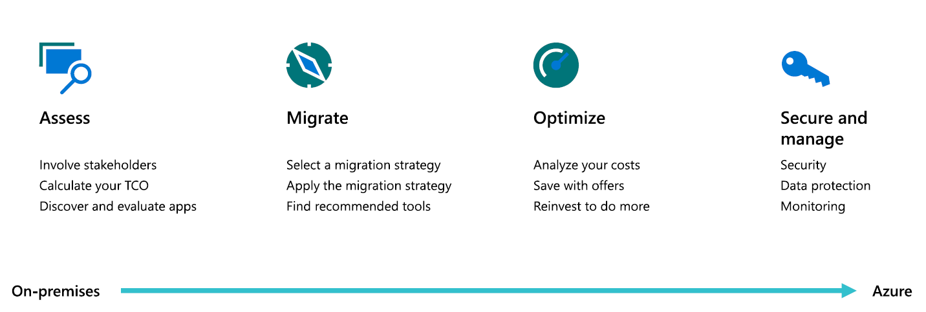
Migration Journey

Slide 10
WHAT’S NEW IN SQL SERVER 2017 SINCE 2008 R2
OLTP Performance
Security
Business Intelligence
Hybrid Cloud
Real-time operational analytics with in-memory OLTP or on disk
In-memory for more applications
Unparalleled scalability with Windows Server 2016, with 12TB memory and Windows Server 2016 max cores
Enhanced AlwaysOn, with 8 secondaries and Replica Wizard
Multiple node failover clustering (3 synchronous, up to 8 replicas)
In memory OLTP
Buffer Pool Extension to SSDs
Enhanced query processing
Resource Governor adds IO governance
SysPrep as cluster level
Predictable performance with tiering of compute, network and story with Windows Server 2012 R2
Delayed Durability
Clustered Shared Volume support, VHDX support (Windows Server 2012 R2)
Manage on-premises and cloud apps (System Center 2012 R2)
Query optimization enhancements
Recovery Advisor
Windows Server Core
Live Migration
Online operations enhancements
Query Store
Temporal support
SQL Server Data Tools
Local DB runtime (Express)
Data-tier application component project template
Data-Tier Application Framework (DAC Fx)
Interoperability support (ADO.NET, ODBC, JDBC, PDO, ADO APIs and .NET C/C++, Java, Linux and PHP platforms)
Enhanced support for ANSI SQL standards
Transact-SQL Static Code Analysis tools
Transact-SQL code snippets
Intellisense
FileTable build on FILESTREAM
Remote Blob Storage with SharePoint 2010
Statistical Semantic Search
Spatial features, Full Globe and arcs
Large user-defined data types
Distributed Replay
Contained Database Authentication
System Center Management Pack for SQL Server 2012
Windows PowerShell 2.0 support
Multi-server Management with SQL Server Utility Control Point
Data Tier Application Component
Automatic Plan Correction
Transparent Data Encryption
Always Encrypted
Enhanced separation of duty
Row-level security
Dynamic data masking
Enhanced separation of duties
Default schema for groups
SQL Server Audit
SQL Server fine-grained auditing
Enhanced connectors, new transformations, object-level security, ragged hierarchies**
Graph data support
Mobile BI
Enhanced SSIS
Enterprise-grade Analysis Services
Advanced tabular models
In-memory analytics
Enhanced multidimensional models
JSON support
Enhanced DQS
Enhanced MDS
Modern Reporting Services
Temporal tables
Advanced data mining
Create mobile reports using the SQL Server Mobile Report Publisher
Consume with Power BI mobile apps
Azure HDInsight Service
Power BI
Power Map for Excel
Mash up data from different sources, such as Oracle & Hadoop
HA for StreamInsight, complex event processing
SQL Server Data Tools support for BI
Change Data Capture for Oracle
Import PowerPivot models into Analysis Services
Enhanced productivity and performance
Power View
Configurable reporting alerts
Reporting as SharePoint Shared Service
Build organization knowledge base
Connect to 3rd party data cleansing providers
Master Data Hub
Master Data Services Add-in for Excel
Graphical tools in SSIS
Extensible object model
SSIS as a Server
Broader data integration with more sources: DB vendors, cloud, Hadoop
Pipeline improvements
Stretch database
Partitioning for efficient data loading
Hybrid scenarios with SSIS
Enhanced backup to Azure
Easy migration to the cloud
Simplified cloud DR with AlwaysOn replicas
Simplified backup to Azure
Support for backup of previous versions of SQL Server to Azure
Cloud back-up encryption support
Simplified cloud Disaster Recovery with AlwaysOn replicas in Azure VMs
New Azure Deployment UI for SQL Server
Larger SQL Server VMs and memory sizes available in Azure
SQL Server Data Tools
Snapshot backups to Azure via SQL Server Management Studio
Data Warehousing
Advanced Analytics
Adaptive Query Processing
Operational analytics
In-memory ColumnStore
Deployment rights for APS
Enhanced In-memory ColumnStore for DW
PolyBase for simple T-SQL to query structured and unstructured data
Enhanced database caching
Up to 15,000 partitions
Analytics Platform System
Python integration**
R built-in to your T-SQL
RRE APIs with full parallelism and no memory limits for scale/performance
Built-in In-memory Advanced Analytics
Advanced tabular model
Direct query
Advanced data mining
SSDT in Visual Studio
Platform
Linux support
Container support
**Available for Windows Server only.
Notes:
Complete inventory of features since 2008 R2 by pillar for customers upgrading from SQL Server 2008 R2.

